Slide 1
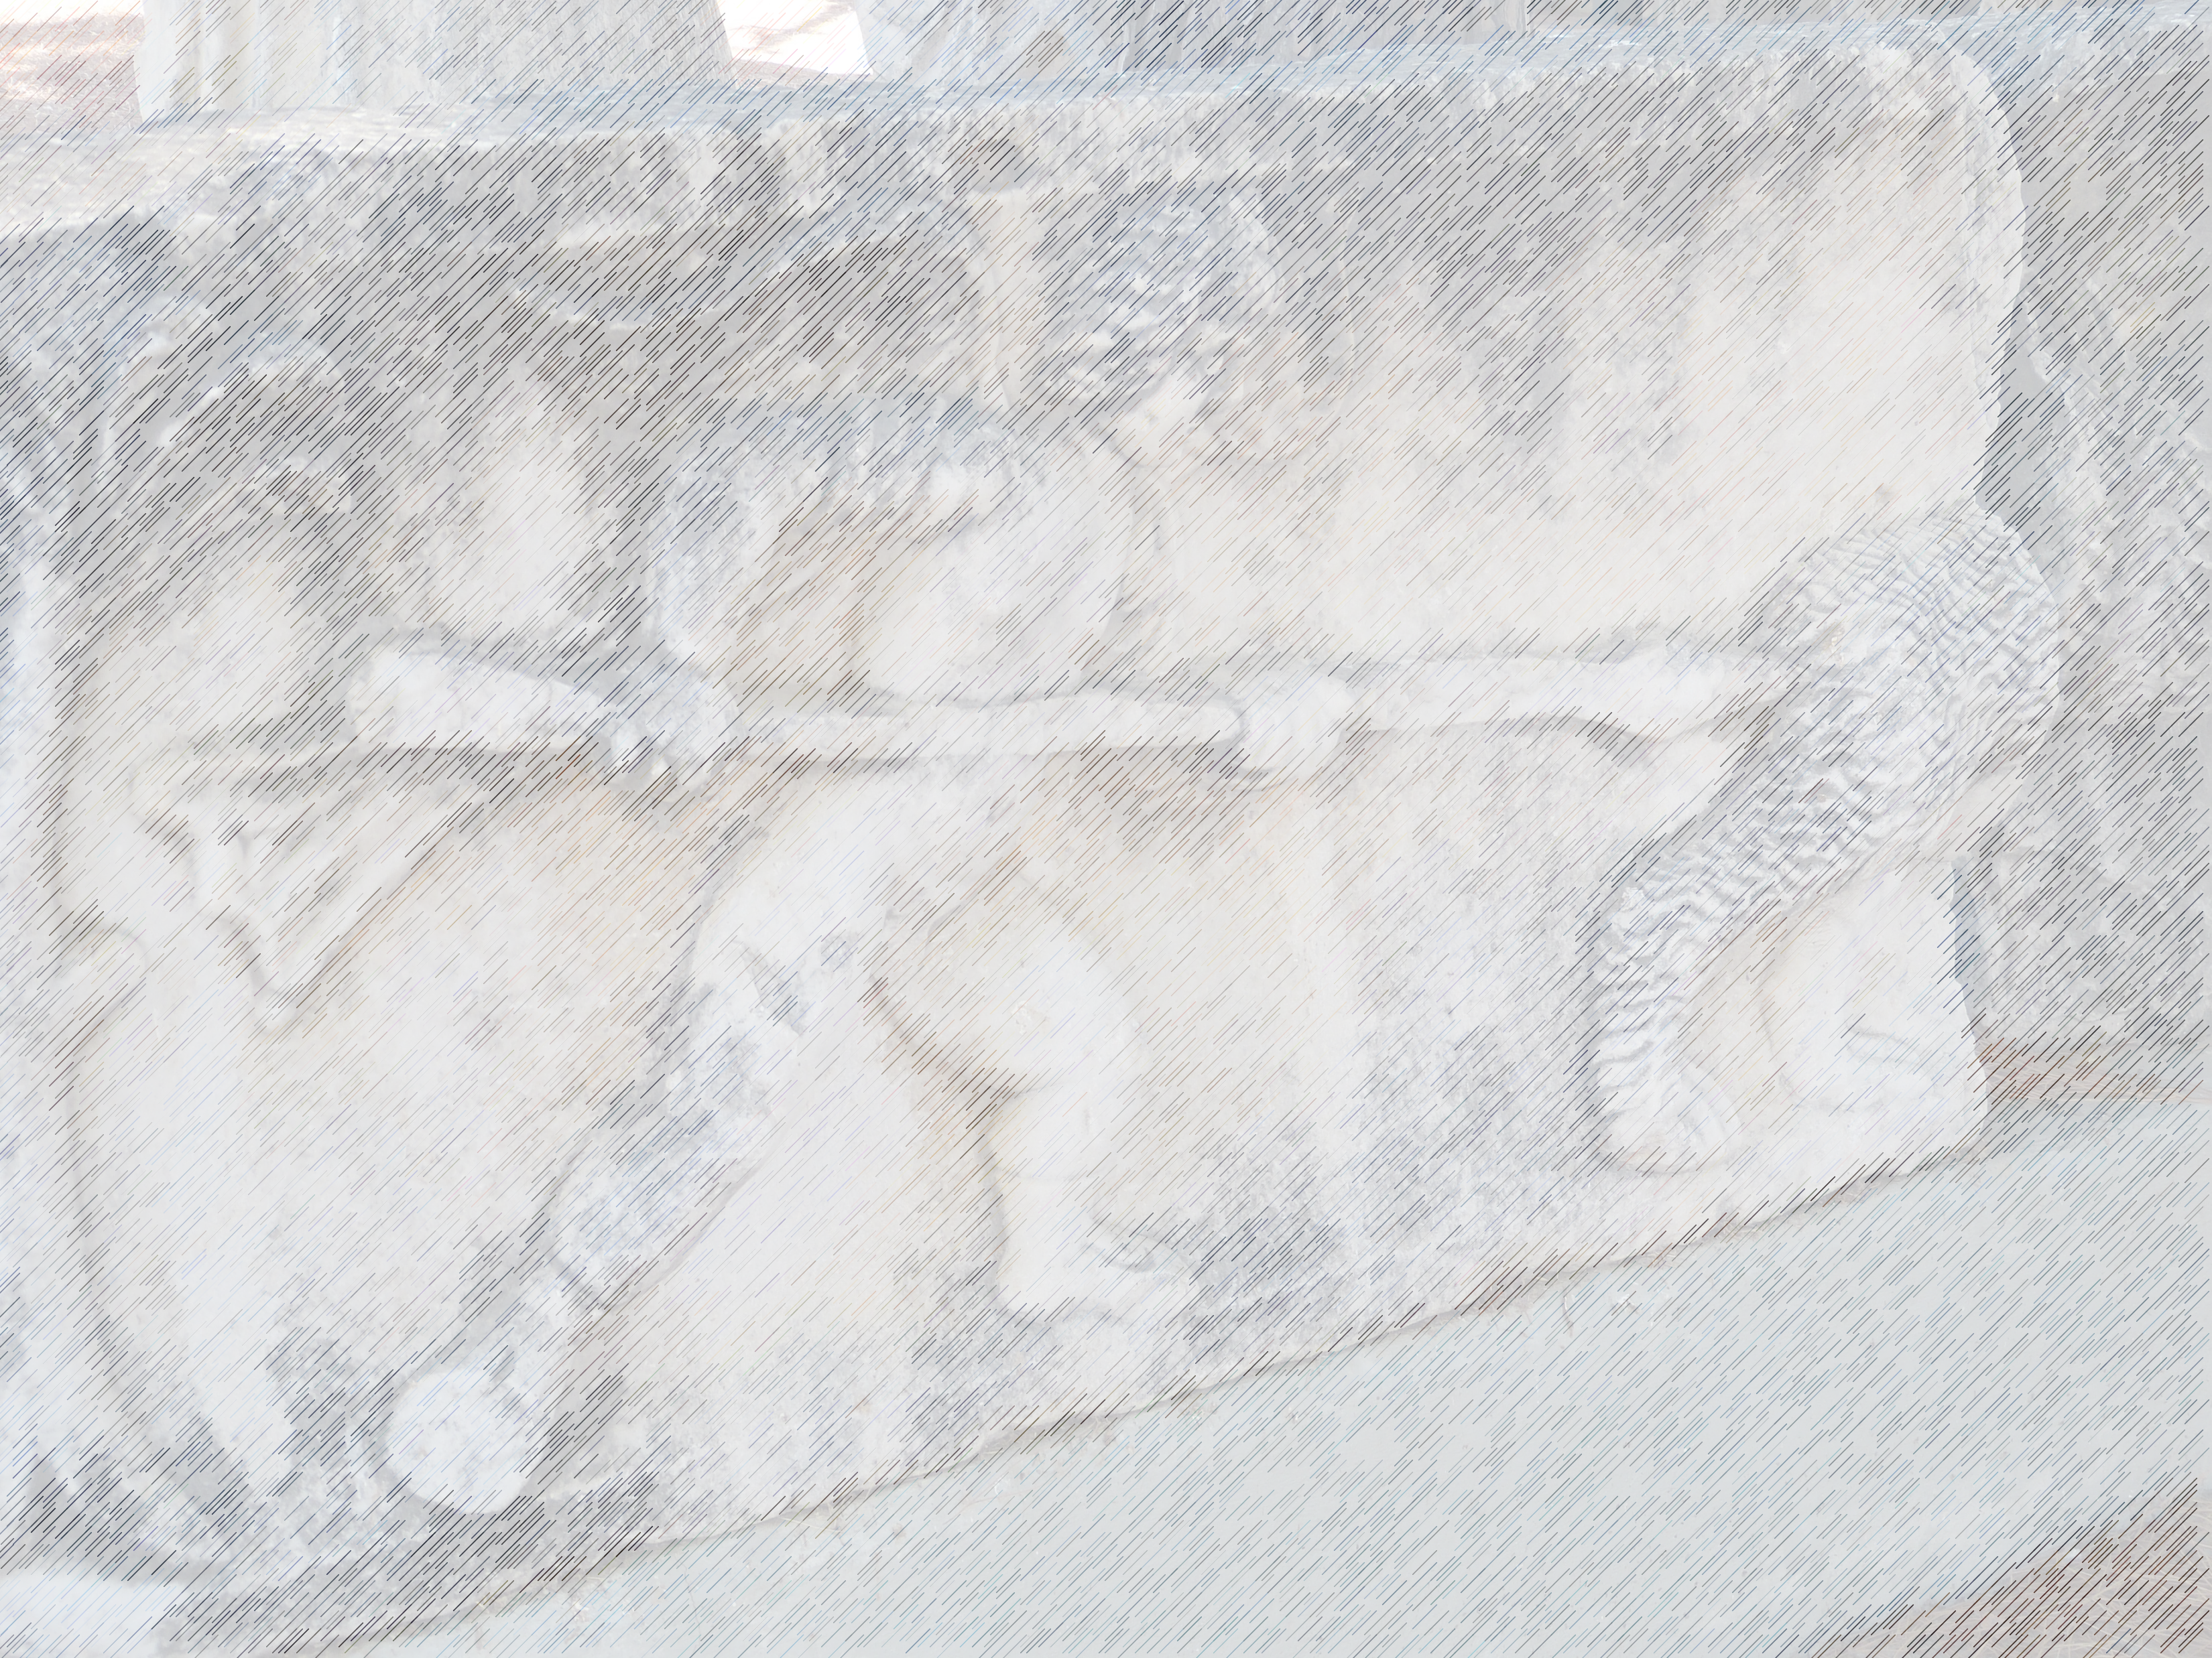
Hated by the World
John 15: 18-25

Slide 2
Hated by the World
John 15: 18-25
“Praemonitus praemunitus”—forewarned is forearmed

Slide 3
Hated by the World
John 15: 18-25
“Praemonitus praemunitus”—forewarned is forearmed
Jesus preparing disciples for his departure

Slide 4
Hated by the World
John 15: 18-25
“Praemonitus praemunitus”—forewarned is forearmed
Jesus preparing disciples for his departure
Opposition awaited them

Slide 5
Hated by the World
John 15: 18-25
“Praemonitus praemunitus”—forewarned is forearmed
Jesus preparing disciples for his departure
Opposition awaited them
Context of his assured presence

Slide 6
Hated by the World
John 15: 18-25
1. Hated like Jesus vv.18-25

Slide 7
Hated by the World
John 15: 18-25
1. Hated like Jesus vv.18-25
Jesus unites or divides

Slide 8
Hated by the World
John 15: 18-25
1. Hated like Jesus vv.18-25
Jesus unites or divides
  “the world” = rebellious world against God – 1 John 5:19

Slide 9
Hated by the World
John 15: 18-25
1. Hated like Jesus vv.18-25
Jesus unites or divides
  “the world” = rebellious world against God – 1 John 5:19
  No fence sitting – either for/against

Slide 10
Hated by the World
John 15: 18-25
1. Hated like Jesus vv.18-25
Jesus unites or divides
Hatred because he exposes sin

Slide 11
Hated by the World
John 15: 18-25
1. Hated like Jesus vv.18-25
Jesus unites or divides
Hatred because he exposes sin
His teaching + miracles – greater responsibility

Slide 12
Hated by the World
John 15: 18-25
1. Hated like Jesus vv.18-25
Jesus unites or divides
Hatred because he exposes sin
His teaching + miracles – greater responsibility
Clear evidence everywhere

Slide 13
Hated by the World
John 15: 18-25
1. Hated like Jesus vv.18-25
Jesus unites or divides
Hatred because he exposes sin
If popular, ask why…

Slide 14
Hated by the World
John 15: 18-25
1. Hated like Jesus vv.18-25
Jesus unites or divides
Hatred because he exposes sin
If popular, ask why…
  Rowan Atkinson – plea for free speech

Slide 15
Hated by the World
John 15: 18-25
1. Hated like Jesus vv.18-25
Jesus unites or divides
Hatred because he exposes sin
If popular, ask why…
  Rowan Atkinson – plea for free speech
  Lukewarm “Christians” – no cause for offence

Slide 16
Hated by the World
John 15: 18-25
1. Hated like Jesus vv.18-25
Jesus unites or divides
Hatred because he exposes sin
If popular, ask why…
God’s sovereignty manifested v.25

Slide 17
Hated by the World
John 15: 18-25
1. Hated like Jesus vv.18-25
Jesus unites or divides
Hatred because he exposes sin
If popular, ask why…
God’s sovereignty manifested v.25
Hated because different

Slide 18
Hated by the World
John 15: 18-25
1. Hated like Jesus vv.18-25
Jesus unites or divides
Hatred because he exposes sin
If popular, ask why…
God’s sovereignty manifested v.25
Hated because different
Chosen “out of this world”

Slide 19
Hated by the World
John 15: 18-25
1. Hated like Jesus vv.18-25
Jesus unites or divides
Hatred because he exposes sin
If popular, ask why…
God’s sovereignty manifested v.25
Hated because different
Chosen “out of this world”
  Divine election

Slide 20
Hated by the World
John 15: 18-25
1. Hated like Jesus vv.18-25
Jesus unites or divides
Hatred because he exposes sin
If popular, ask why…
God’s sovereignty manifested v.25
Hated because different
Chosen “out of this world”
Different master

Slide 21
Hated by the World
John 15: 18-25
1. Hated like Jesus vv.18-25
Jesus unites or divides
Hatred because he exposes sin
If popular, ask why…
God’s sovereignty manifested v.25
Hated because different
Chosen “out of this world”
Different master
We know the Father

Slide 22
Hated by the World
John 15: 18-25
1. Hated like Jesus vv.18-25
Jesus unites or divides
Hatred because he exposes sin
If popular, ask why…
God’s sovereignty manifested v.25
Hated because different
Chosen “out of this world”
Different master
We know the Father
  Nonviolent response

Slide 23
Hated by the World
John 15: 18-25
Hated like Jesus vv.18-25
Testify like Jesus vv.26-27

Slide 24
Hated by the World
John 15: 18-25
Hated like Jesus vv.18-25
Testify like Jesus vv.26-27
Testify thanks to the Spirit

Slide 25
Hated by the World
John 15: 18-25
Hated like Jesus vv.18-25
Testify like Jesus vv.26-27
Testify thanks to the Spirit
Testify through the Word and personal testimony

Slide 26
Hated by the World
John 15: 18-25
Hated like Jesus vv.18-25
Testify like Jesus vv.26-27
Testify thanks to the Spirit
Testify through the Word and personal testimony
“Without the witness of the Spirit, the disciple’s witness would be powerless; without the disciple’s witness, the Spirit would be restricted in his means of expression.” (Merrill Tenney)

Slide 27
Hated by the World
John 15: 18-25
Hated like Jesus vv.18-25
Testify like Jesus vv.26-27
Testify thanks to the Spirit
Testify through the Word and personal testimony
“Without the witness of the Spirit, the disciple’s witness would be powerless; without the disciple’s witness, the Spirit would be restricted in his means of expression.” (Merrill Tenney)
Testimony of disciples

Slide 28
Hated by the World
John 15: 18-25
Hated like Jesus vv.18-25
Testify like Jesus vv.26-27
Application

Slide 29
Hated by the World
John 15: 18-25
Hated like Jesus vv.18-25
Testify like Jesus vv.26-27
Application
More contact with the world

Slide 30
Hated by the World
John 15: 18-25
Hated like Jesus vv.18-25
Testify like Jesus vv.26-27
Application
More contact with the world
More awareness of opportunities

Slide 31
Hated by the World
John 15: 18-25
Hated like Jesus vv.18-25
Testify like Jesus vv.26-27
Application
More contact with the world
More awareness of opportunities
More anticipation of mixed results

